Slide 1
The following plots, graphs and information have been generated in the context of a SWESNET Consistent Communication exercise. The data has been taken from past periods (in 2017 or other years) and have been partially modified in order to support the communication exercise activity. It does not reflect the real-time space weather conditions and should not be used or distributed outside of the coordinated event exercise.

Slide 2
Issue time of the data:
YYYY – M1 – D1 UTC

Slide 3
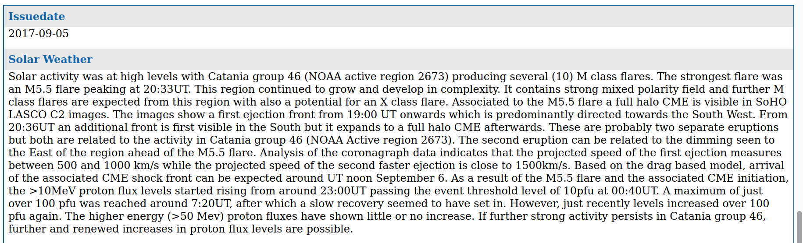
S-ESC
S.110 SIDC Daily space weather bulletin

Slide 4
S.112a SIDC Solar GOES-flare alert
No alert

Slide 5
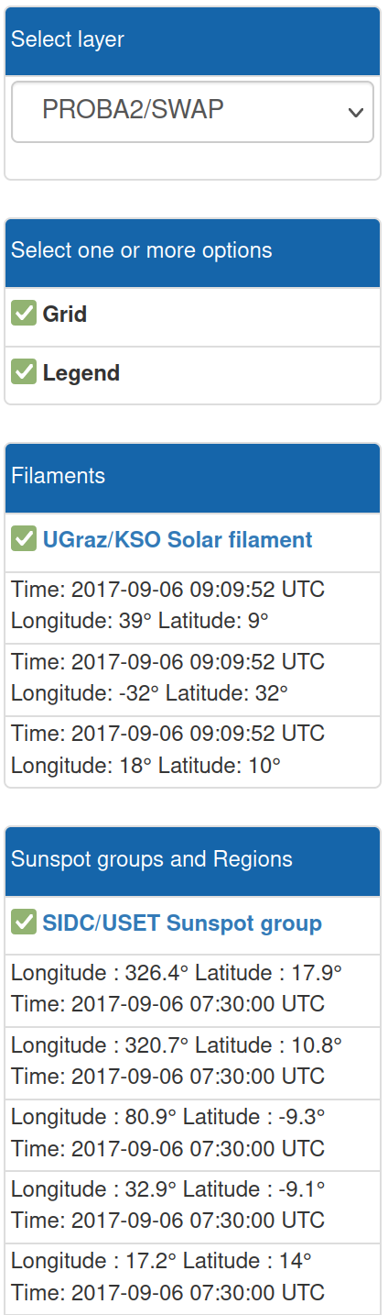
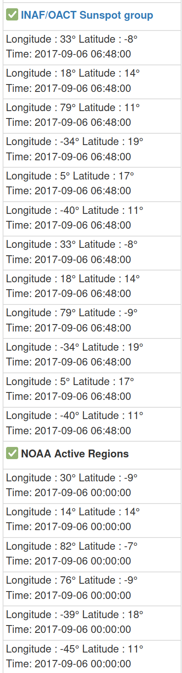
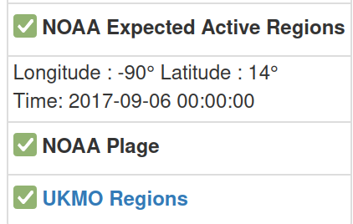
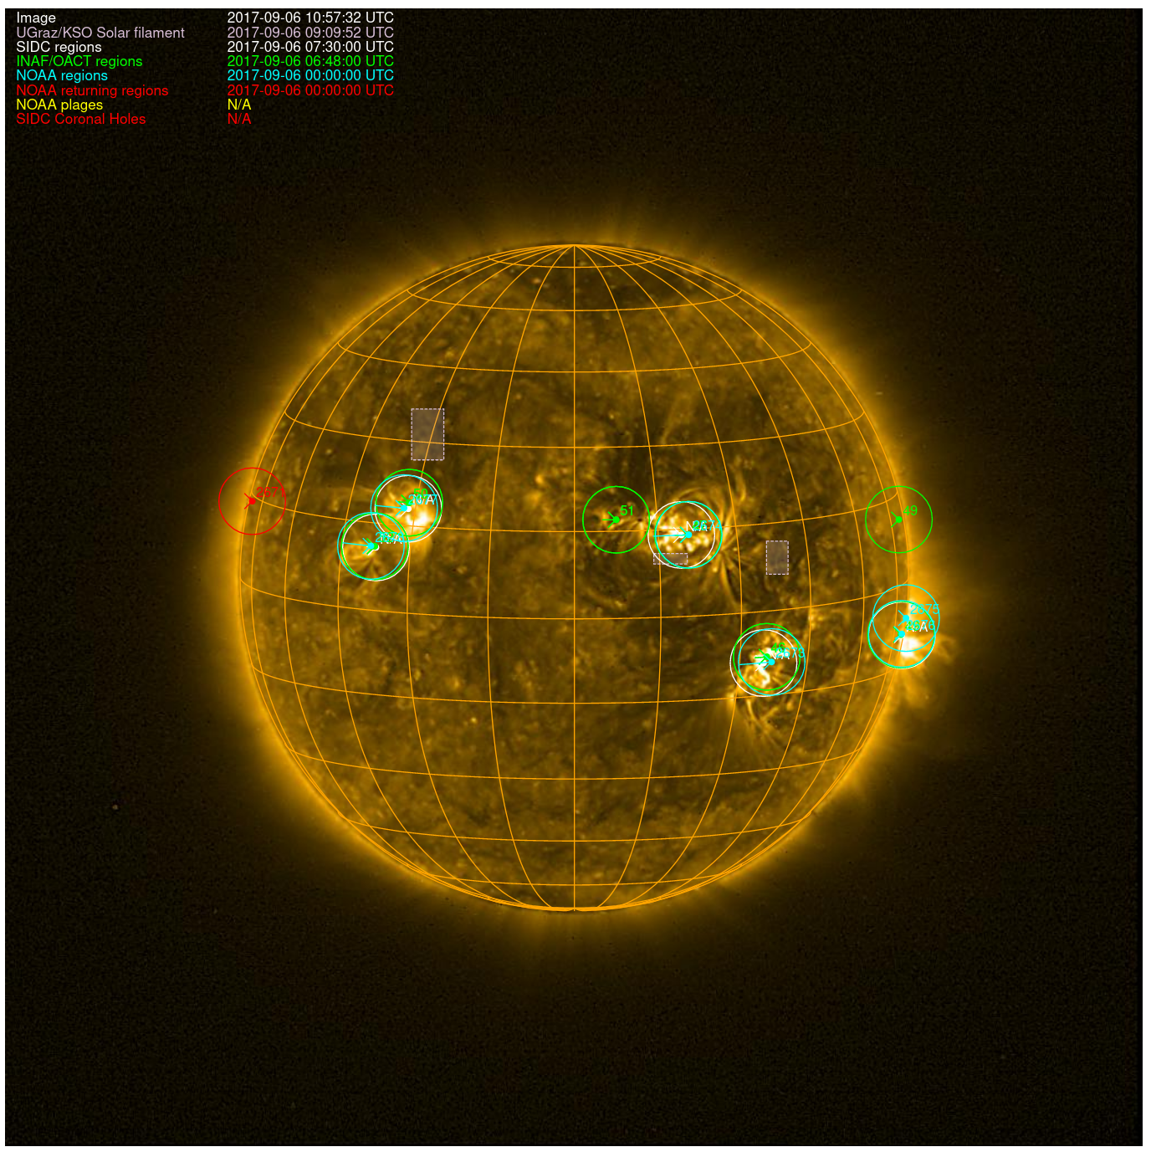
S.101c SIDC Solar map
https://ssa.sidc.be/prod/WEB/solarmap/index.php?&features_width=680&timenavbar.date=2017-09-06T11:00:00Z%20&images_sun=SWAP&features_grid=1&features_legend=1&filaments_kso=1&regions_sidc_sunspot=1&regions_inaf_sunspot=1&regions_noaa_region=1&regions_noaa_returning=1&regions_noaa_plages=1&regions_ukmo_sunspot=1&coronal_holes_sidc=1

Slide 6
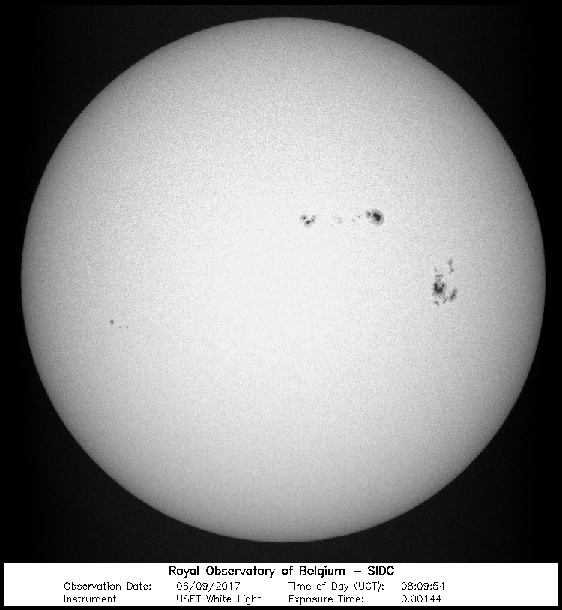
S.104 SIDC/USET White light Solar images

Slide 7
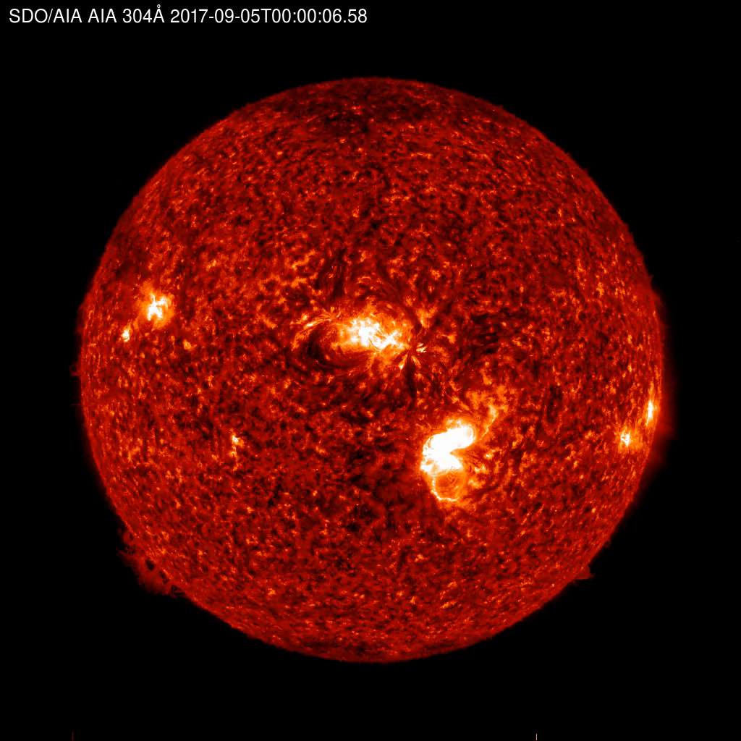
S.106 SDO/AIA Latest Solar EUV images

Slide 8
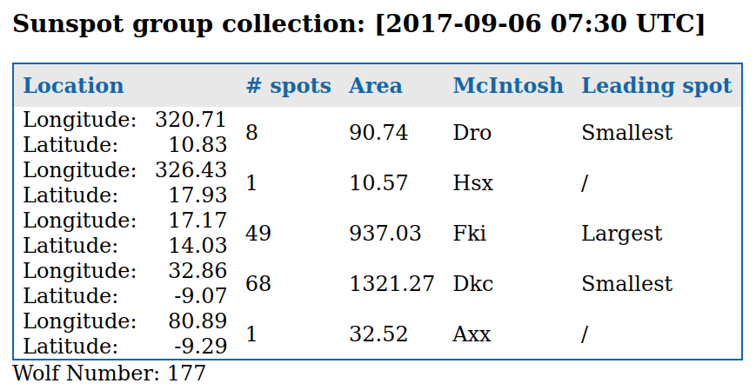
S.123b SIDC/USET Sunspot group characteristics

Slide 9
S.102 Proba2/LYRA Data

Slide 10
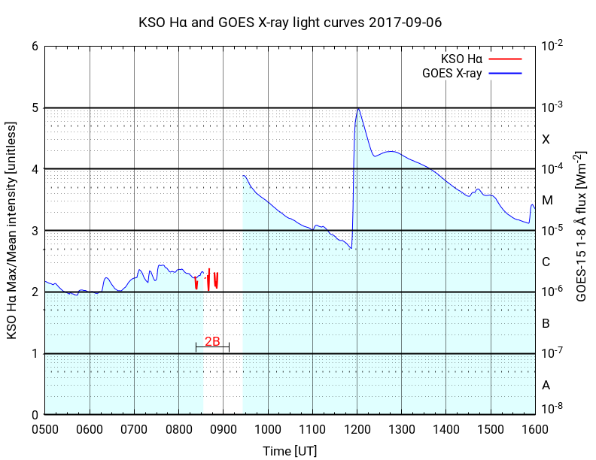
S.107g UGraz/KSO Halpha light curves

Slide 11
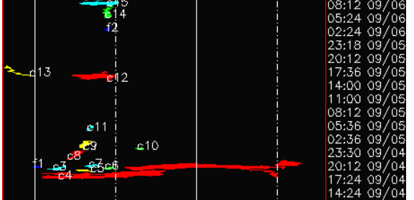
S.111 SIDC/CACTus Automated CME detection

