Slide 1
The following plots, graphs and information have been generated in the context of a SWESNET Consistent Communication exercise. The data has been taken from past periods (in 2017 or other years) and have been partially modified in order to support the communication exercise activity. It does not reflect the real-time space weather conditions and should not be used or distributed outside of the coordinated event exercise.

Slide 2
Issue time of the data:
YYYY – M1 – D4 UTC

Slide 3
R-ESC DATA: INTRODUCTION
The main format for every SWE event day is: 07:00 UTC
COMESEP update (only if a significant event is reported + previous day updates after 16:00 UTC if relevant) 12:00 UTC
COMESEP update(only if a significant event is reported) + SREM update for the previous day (available at around 12:00 UTC) 16:00 UTC
COMESEP update (only if a significant event is reported) + SPM forecast for the next day (available at around 14:30 UTC) + EPT flux for previous week minus last two days

Slide 4
DAY 5.3
FRIDAY, 15 SEPTEMBER 2017 16:00 UT

Slide 5
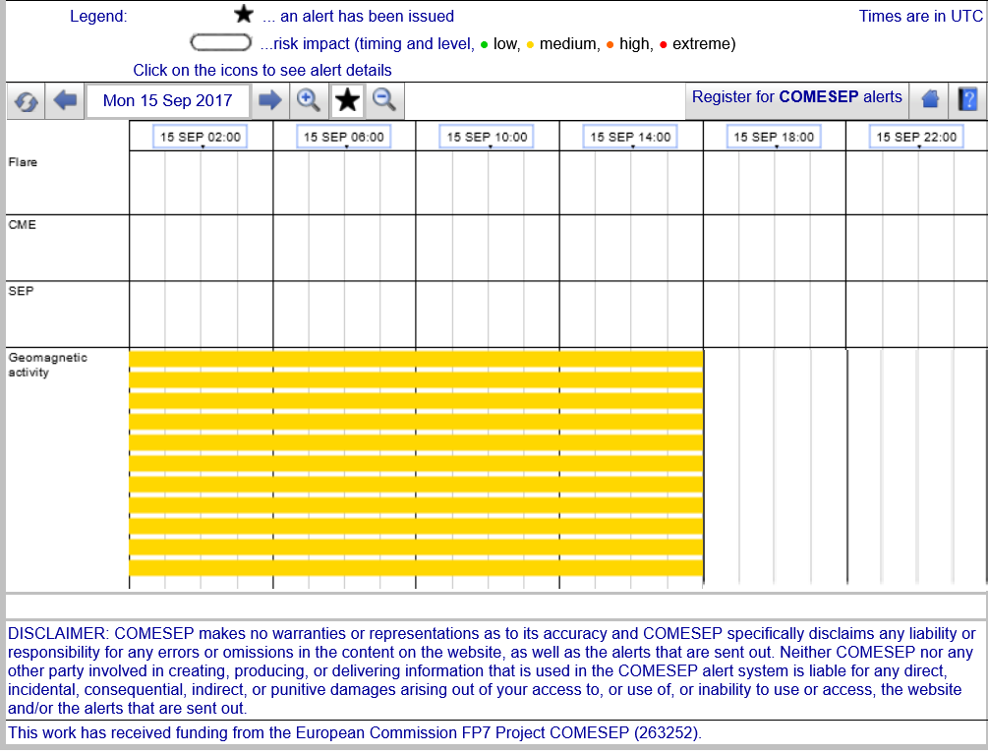
15/09/2017 16:00 UT R.134 COMESEP
FORECASTS on 15/09/2017

Slide 6
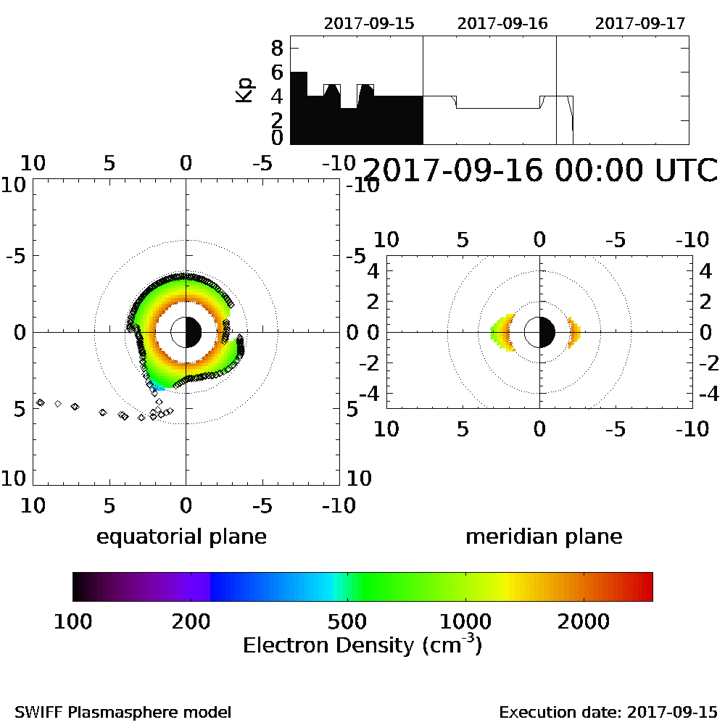
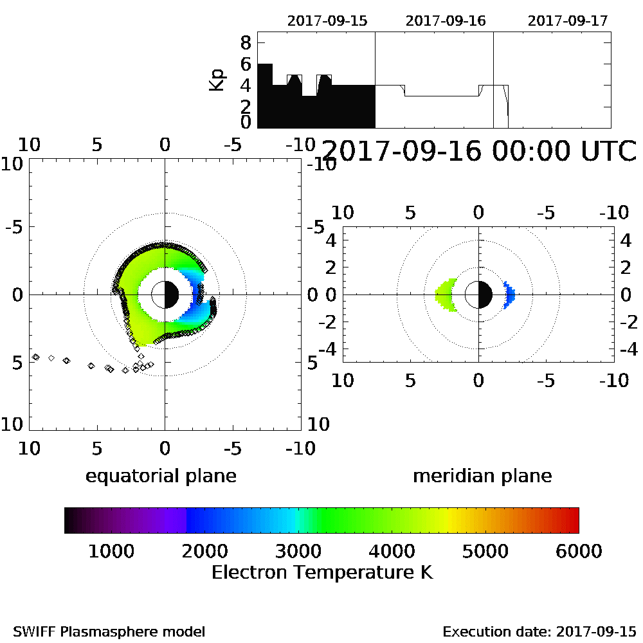


15/09/2017 16:00 UT R.136 SPM
R.136 SPM Forecast for 16th Sept. 2017:
NOTE: R.136 SPM runs once per day using the Kp forecast made available by NOAA/SWPC at 12:30 UT providing a forecast for the electron density
and temperature for the following day. The model is made available in the form of a movie(.GIF format); hover over to play.

Slide 7
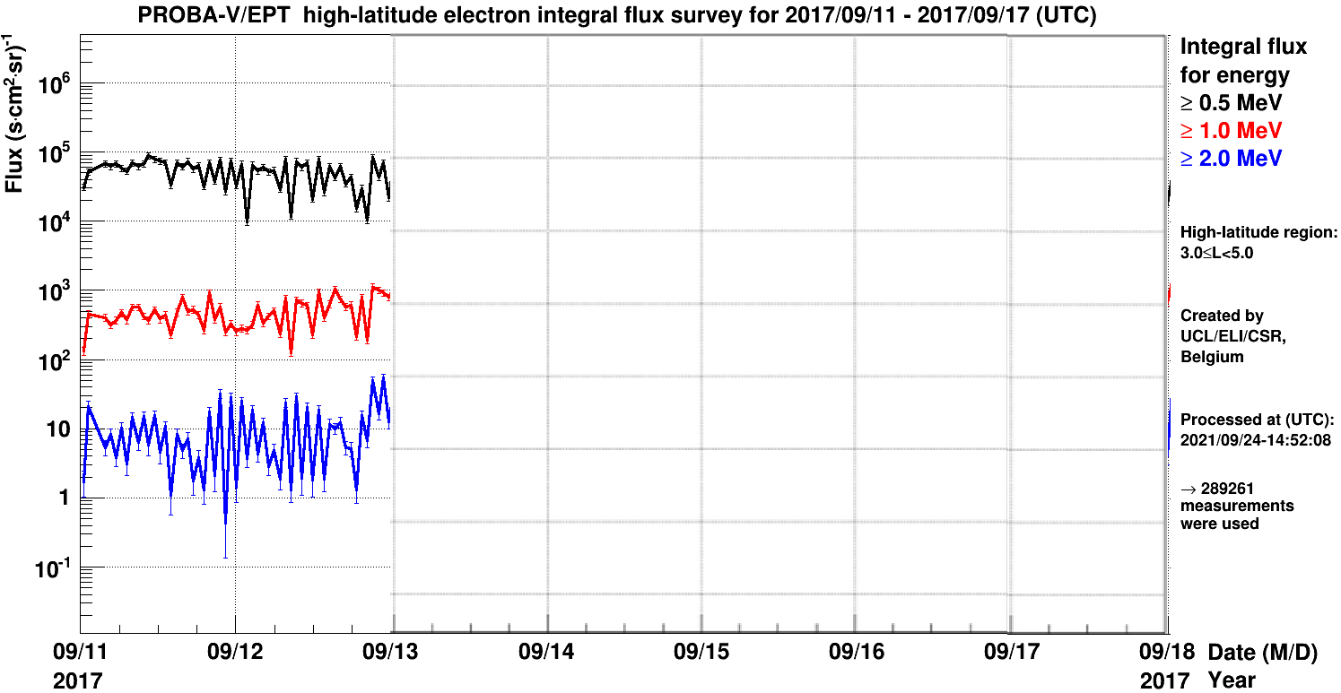
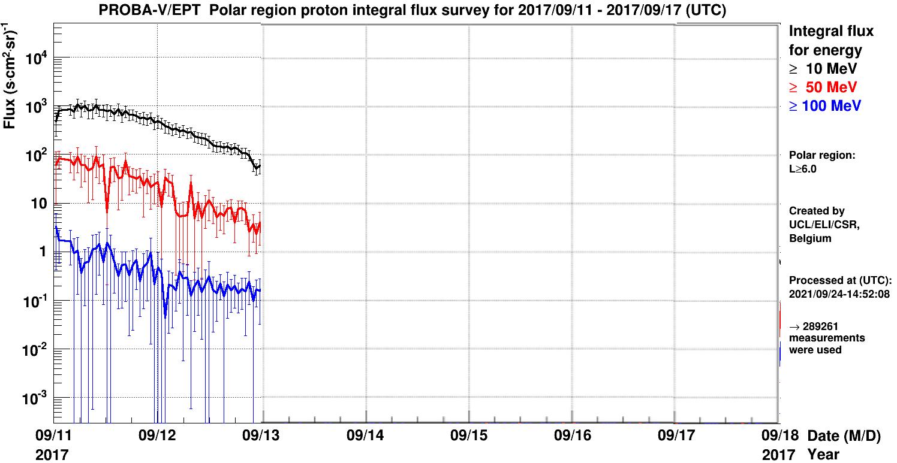
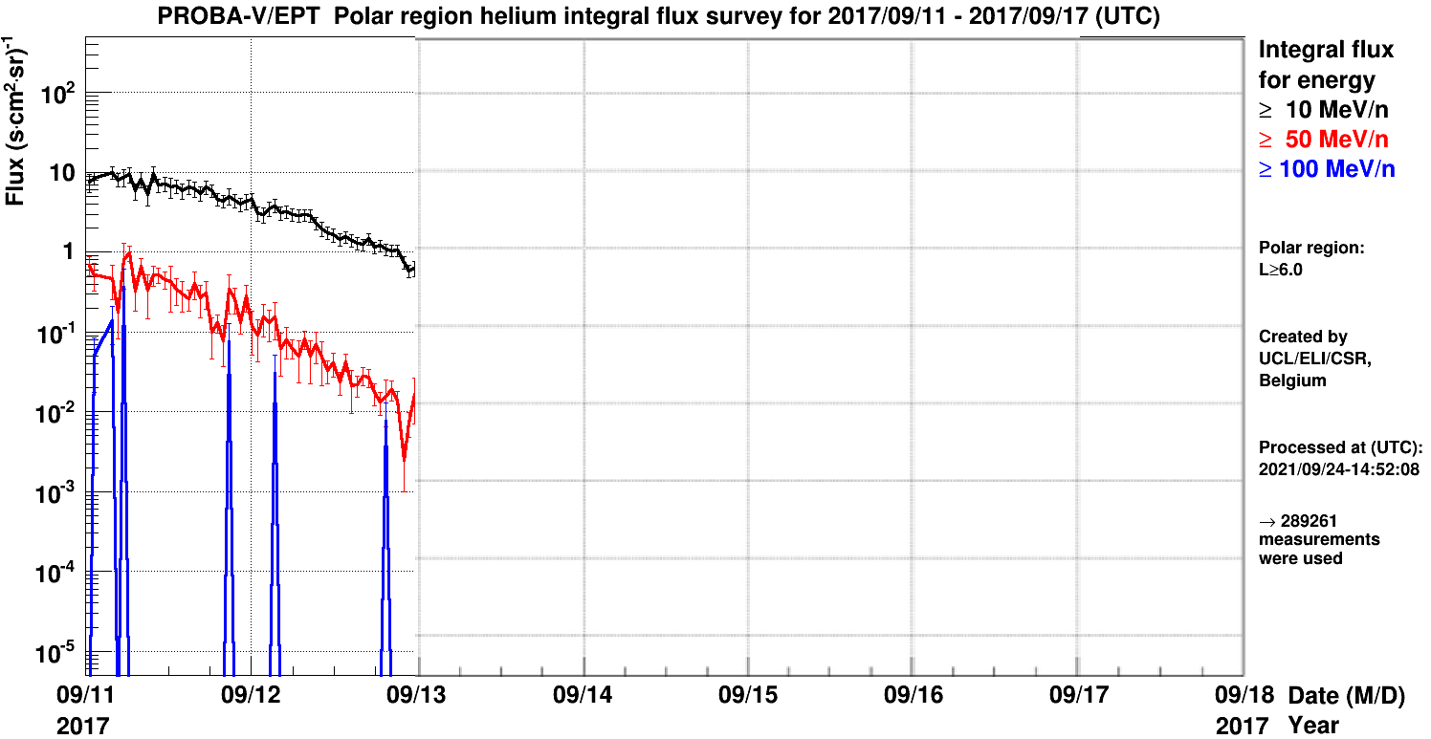
15/09/2017 16:00 UT PROBA-V/EPT: R.160, R.161, R.162
R.160 PROBA-V/EPT High-latitude/polar electron flux survey
R.161 PROBA-V/EPT High-latitude/polar proton flux survey
R.162 PROBA-V/EPT High-latitude/polar helium flux survey

Slide 8
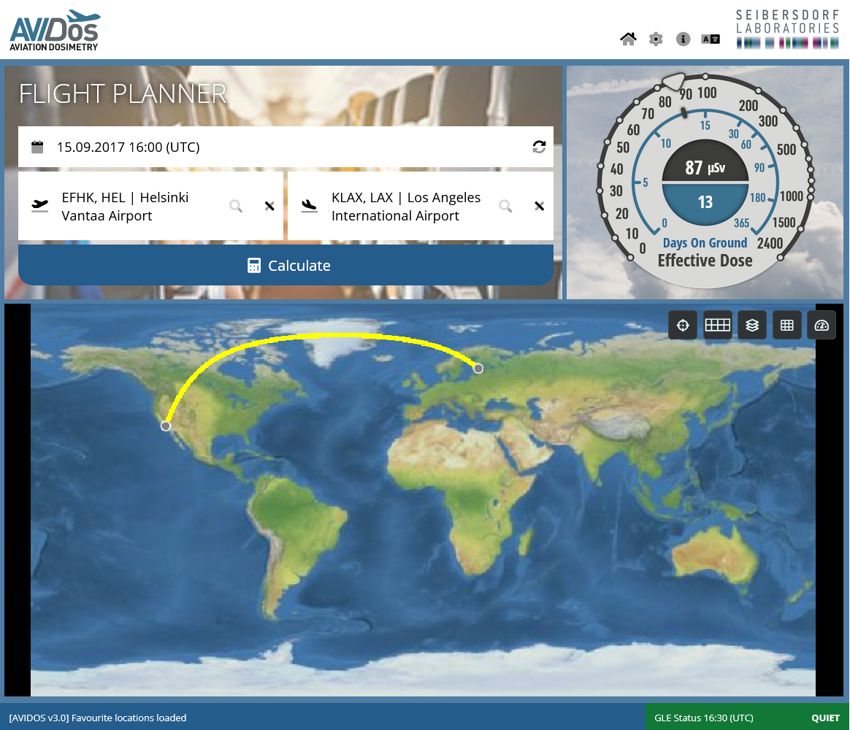
15/09/2017 16:00 UT R.101 AVIDOS

