Slide 1
The following plots, graphs and information have been generated in the context of a SWESNET Consistent Communication exercise. The data has been taken from past periods (in 2017 or other years) and have been partially modified in order to support the communication exercise activity. It does not reflect the real-time space weather conditions and should not be used or distributed outside of the coordinated event exercise.

Slide 2
Issue time of the data:
YYYY – M1 – D1 UTC

Slide 3
R-ESC DATA: INTRODUCTION
The main format for every SWE event day is:
07:00 UTC
R.134 COMESEP update (only if a significant event is reported + previous day updates after 16:00 UTC if relevant)
12:00 UTC
R.134 COMESEP update(only if a significant event is reported) + R.119 SREM update for the previous day (available at around 12:00 UTC)
16:00 UTC
R.134 COMESEP update (only if a significant event is reported) + SPM forecast for the next day (available at around 14:30 UTC) + EPT flux for previous week minus last two days.

Slide 4
DAY 2.2
THURSDAY, 7 SEPTEMBER 2017 12:00 UT

Slide 5
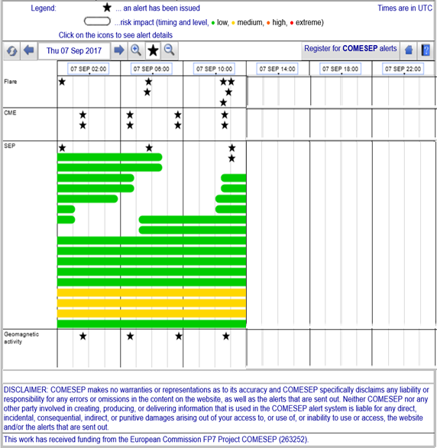
07/09/2017 12:00 UT R.134 COMESEP
R.134 COMESEP Forecasts at 10:04 UT (SEPFORECAST)
The risk level for a SEP proton storm(>10 MeV) at Earth is LOW due to:
Expected occurrence probability: Unlikely
Expected severity: Minor
The risk level for a SEP proton storm(>60 MeV) at Earth is LOW due to:
Expected occurrence probability: Unlikely
Expected severity: None
R.134 COMESEP Forecasts at 10:25 UT (SEPFORECAST)
The risk level for a SEP proton storm(>10 MeV) at Earth is LOW due to:
Expected occurrence probability: Possible
Expected severity: Minor
The risk level for a SEP proton storm(>60 MeV) at Earth is LOW due to:
Expected occurrence probability: Possible
Expected severity: Minor
R.134 COMESEP Forecasts at 10:29 UT (FLAREMAIL)
A GOES X-ray solar flare of M1.5 magnitude was detected with peak time 2017-09-07T09:54:00Z
R.134 COMESEP Forecasts at 10:49 UT (FLAREMAIL)
A GOES X-ray solar flare of M7.3 magnitude was detected with peak time 2017-09-07T10:15:00Z
R.134 COMESEP Forecasts at 11:00 UT (SEPFORECAST)
Forecast for a SEP radiation storm following a M1.5 flare with peak at 2017-09-07 09:54UT
(protons > 10 MeV: MINOR, UNLIKELY; protons > 60 MeV: NONE, UNLIKELY)
R.134 COMESEP Forecasts at 11:01 UT (SEPFORECAST)
Forecast for a SEP radiation storm following a M7.3 flare with peak at 2017-09-07 10:15UT
(protons > 10 MeV: MINOR, POSSIBLE; protons > 60 MeV: MINOR, POSSIBLE).
R.134 COMESEP Forecasts at 11:01 UT (SEPFORECAST)
Forecast for a SEP radiation storm following a M7.3 flare with peak at 2017-09-07 10:15UT
(protons > 10 MeV: MINOR, POSSIBLE; protons > 60 MeV: MINOR, POSSIBLE).

Slide 6
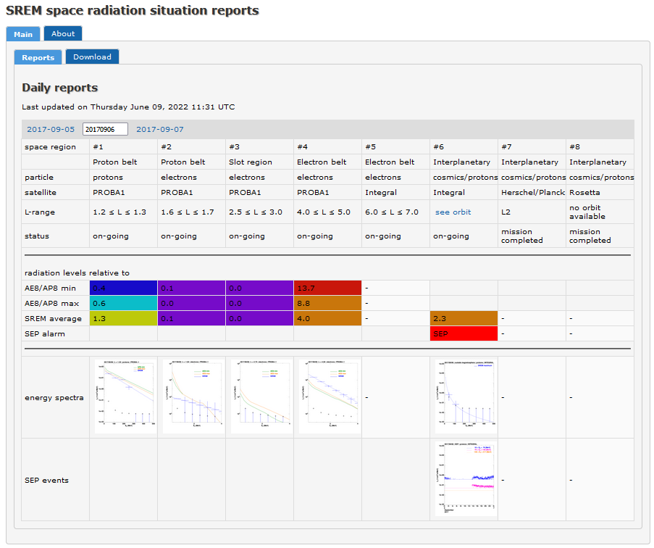
07/09/2017 12:00 UT SREM: R.119
R.119 SREM (#6, Interplanetary, Integral)
Interplanetary SEP alert
(SEP event on 06/09/2017)
Report generated at noon

