Slide 1
The following plots, graphs and information have been generated in the context of a SWESNET Consistent Communication exercise. The data has been taken from past periods (in 2017 or other years) and have been partially modified in order to support the communication exercise activity. It does not reflect the real-time space weather conditions and should not be used or distributed outside of the coordinated event exercise.

Slide 2
Issue time of the data:
YYYY – M1 – D2 UTC

Slide 3
R-ESC DATA: INTRODUCTION
The main format for every SWE event day is:
07:00 UTC
R.134 COMESEP update (only if a significant event is reported + previous day updates after 16:00 UTC if relevant)
12:00 UTC
R.134 COMESEP update(only if a significant event is reported) + SREM update for the previous day (available at around 12:00 UTC)
16:00 UTC
R.134 COMESEP update (only if a significant event is reported) + SPM forecast for the next day (available at around 14:30 UTC) + EPT flux for previous week minus last two days.

Slide 4
DAY 2.1
THURSDAY, 7 SEPTEMBER 2017 07:00 UT

Slide 5
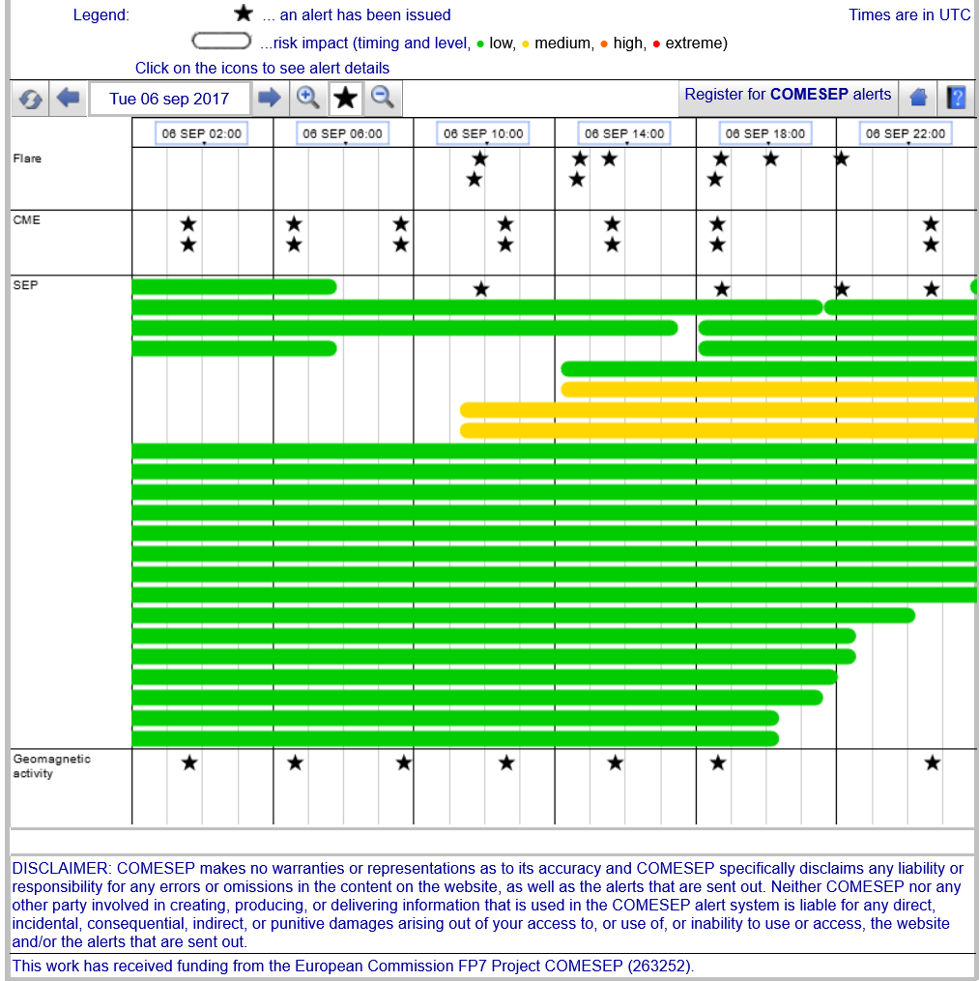
07/09/2017 07:00 UT R.134 COMESEP
FORECASTS on 06/09/2017 (after 16:00 UT)
R.134 COMESEP Forecasts at 20:04 UT (FLAREMAIL)
A GOES X-ray solar flare of M1.4 magnitude was detected with peak time 2017-09-06T19:30:00Z
R.134 COMESEP Forecasts at 20:05 UT (SEPFORECAST)
Forecast for a SEP radiation storm following a M1.4 flare with peak at 2017-09-06 19:30UT
(protons > 10 MeV: MINOR, VERY UNLIKELY).
R.134 COMESEP Forecasts at 22:37 UT (SEPFORECAST)
Forecast for a SEP radiation storm following a X9.3 flare with peak at 2017-09-06 12:02UT,
and a CME with lift-off at 2017-09-06 12:12UT (protons > 10 MeV: MINOR, UNLIKELY;
protons > 60 MeV: MODERATE, UNLIKELY).

Slide 6
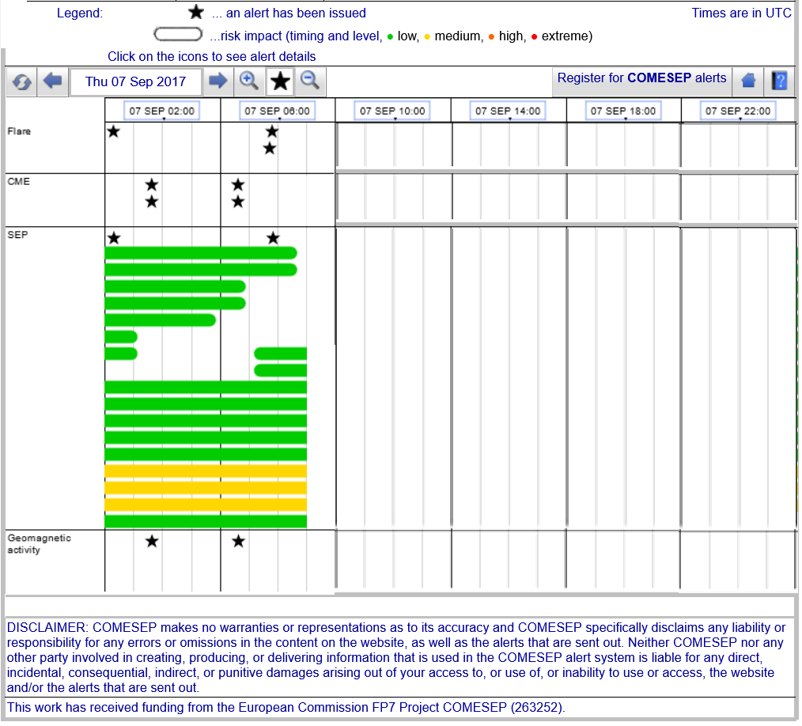
07/09/2017 07:00 UT R.134 COMESEP
FORECASTS on 07/09/2017 (00:00 UT ONWARDS)
R.134 COMESEP Forecasts at 00:14 UT (FLAREMAIL)
A GOES X-ray solar flare of M1.2 magnitude was detected with peak time 2017-09-06T23:39:00Z
R.134 COMESEP Forecasts at 00:15 UT (SEPFORECAST)
Forecast for a SEP radiation storm following a M1.2 flare with peak at 2017-09-06 23:39UT
(protons > 10 MeV: MINOR, VERY UNLIKELY).
R.134 COMESEP Forecasts at 05:390 UT (FLAREMAIL)
A GOES X-ray solar flare of M2.4 magnitude was detected with peak time 2017-09-07T05:02:00Z
R.134 COMESEP Forecasts at 05:390 UT (SEPFORECAST)
Forecast for a SEP radiation storm following a M2.4 flare with peak at 2017-09-07 05:02UT
(protons > 10 MeV: MINOR, UNLIKELY; protons > 60 MeV: NONE, UNLIKELY).

