Slide 1
The following plots, graphs and information have been generated in the context of a SWESNET Consistent Communication exercise. The data has been taken from past periods (in 2017 or other years) and have been partially modified in order to support the communication exercise activity. It does not reflect the real-time space weather conditions and should not be used or distributed outside of the coordinated event exercise.

Slide 2
Issue time of the data:
YYYY – M1 – D4 UTC

Slide 3
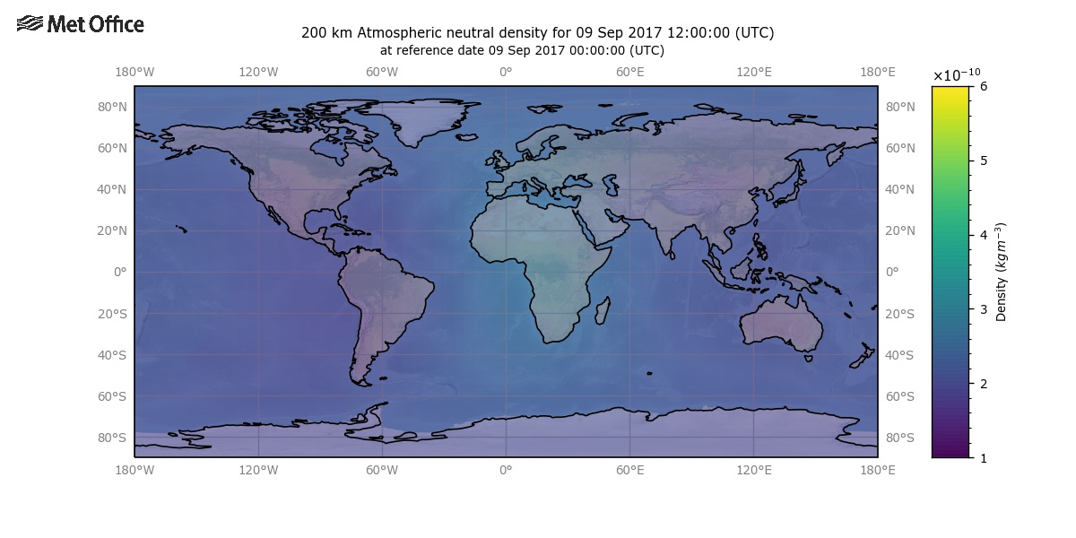
ATMDEN
I.132 Atmospheric Density Estimates of Forecast and Prior Total Density for Atmopsheric Drag Calculation
Notes:
Normal estimated based on the daily prior estimate product. Atmospheric density at LEO (~200 km) has reduced following recent activity with a ~140% global average total density compared to the recent pre-event background
<number>

Slide 4
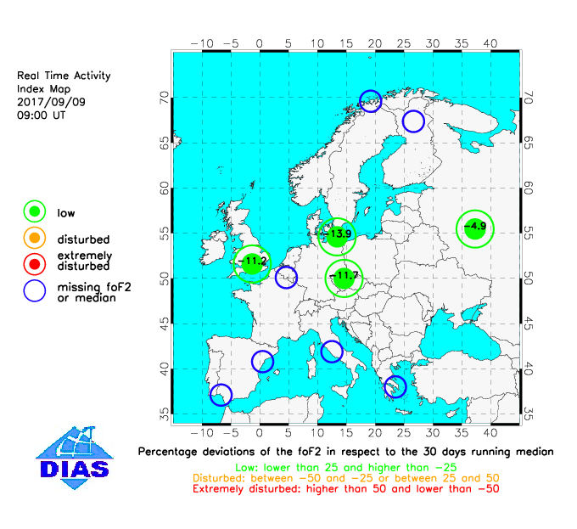
EIS
I.119 Maps, updated in real-time showing the current ionospheric conditions at each station location.
Notes:
foF2 disturbances: significant decreases in foF2 were observed during the last 24 hrs.
foF2 remains degraded compared to quiet conditions
<number>

Slide 5
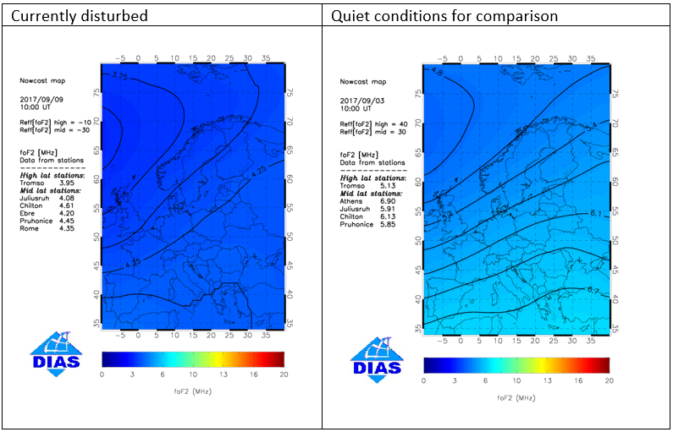
EIS
I.115 Nowcast European maps of foF2 (based on the upgraded SIRMUP model )
(Right plot could be cut off for portal simulation)
Notes:
foF2 disturbances: significant decreases in foF2 were observed during the last 24 hrs.
foF2 remains degraded compared to quiet conditions
<number>

Slide 6
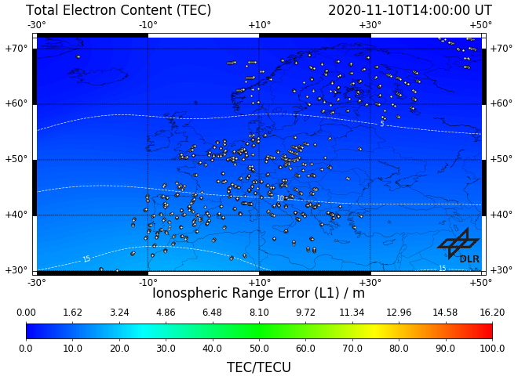
IMPC
I.103b Near-real-time global map of the Total Electron Content (TEC)
2020-11-19
2020-11-17
Right plot for comparison to normal conditions
Notes:
TEC is currently depleted (by about 30 %) compared to quiet conditions. This is a negative ionosphere storm.
<number>

Slide 7
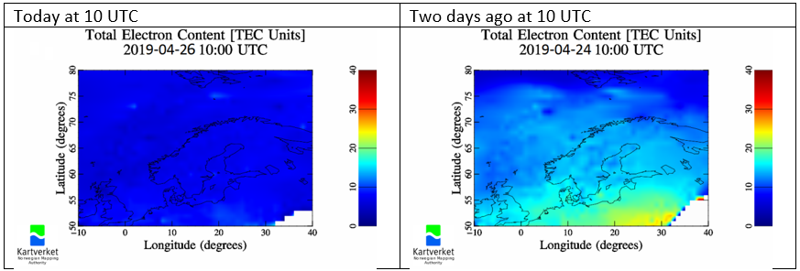
NMA
I.107 VTEC maps (Northern Europe)
Notes:
TEC is suppressed. (Lower-than-normal TEC values during the day over large areas)
<number>

Slide 8
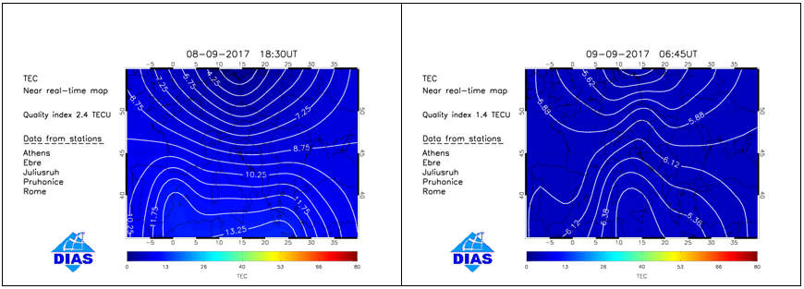
EIS
I.117 Near-real-time TEC maps for the European region (based on the TaD model)
Notes:
TEC disturbances: decreases in TEC were observed during the last 24 hrs.
TEC remains degraded compared to quiet conditions
<number>

Slide 9
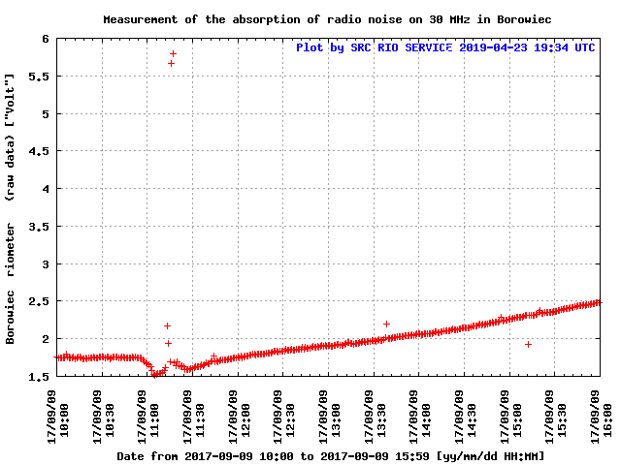
SRC RIO
I.134a Borowiec Riometer raw [V] and relative [dB]
Notes:
Detection of the increase of the signal on 30 MHz at 11:15 and the decrease from the quiet day curve as absorption in ionospheric D layer
<number>

Slide 10
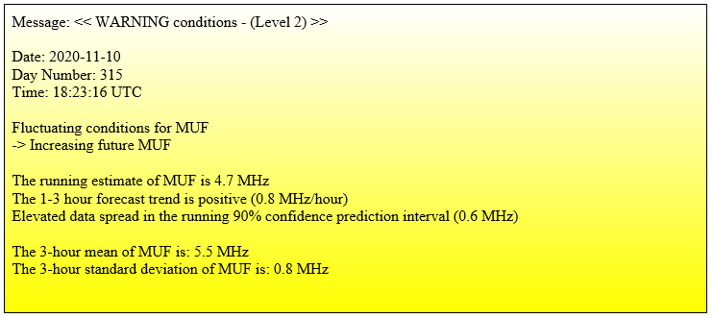
IMPC
I.139 Maximum Usable Frequency for slip-distances of 750 km (MUF750)
Notes:
Increasing MUF indicated
<number>

Slide 11
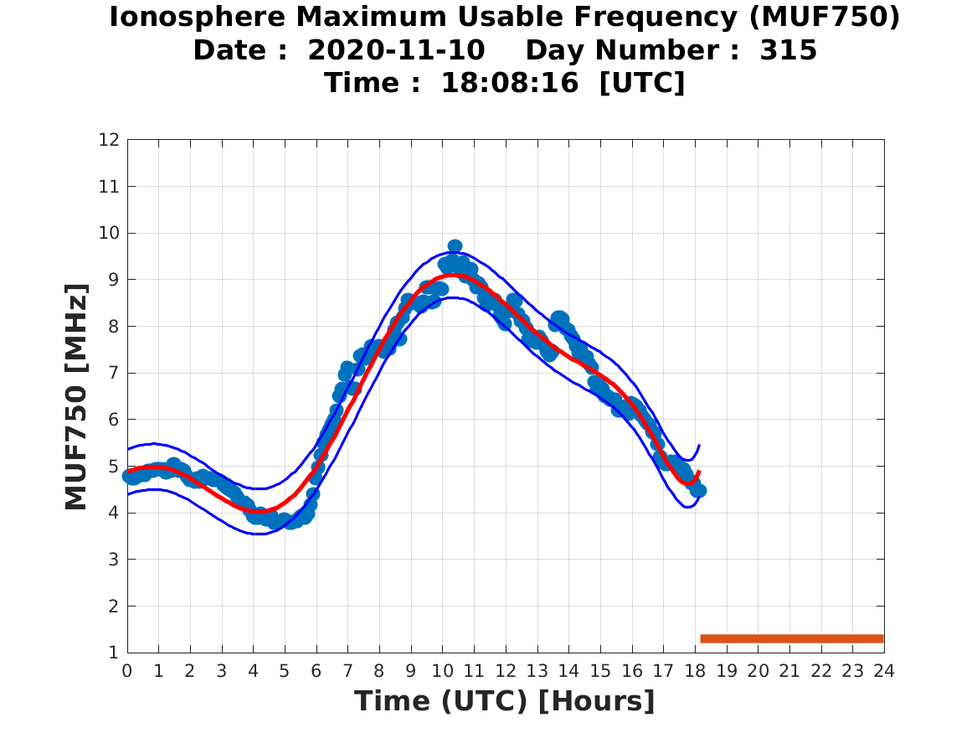
IMPC
I.139 Maximum Usable Frequency for slip-distances of 750 km (MUF750)

