Slide 1
The following plots, graphs and information have been generated in the context of a SWESNET Consistent Communication exercise. The data has been taken from past periods (in 2017 or other years) and have been partially modified in order to support the communication exercise activity. It does not reflect the real-time space weather conditions and should not be used or distributed outside of the coordinated event exercise.

Slide 2
Issue time of the data:
YYYY – M1 – D3 UTC

Slide 3
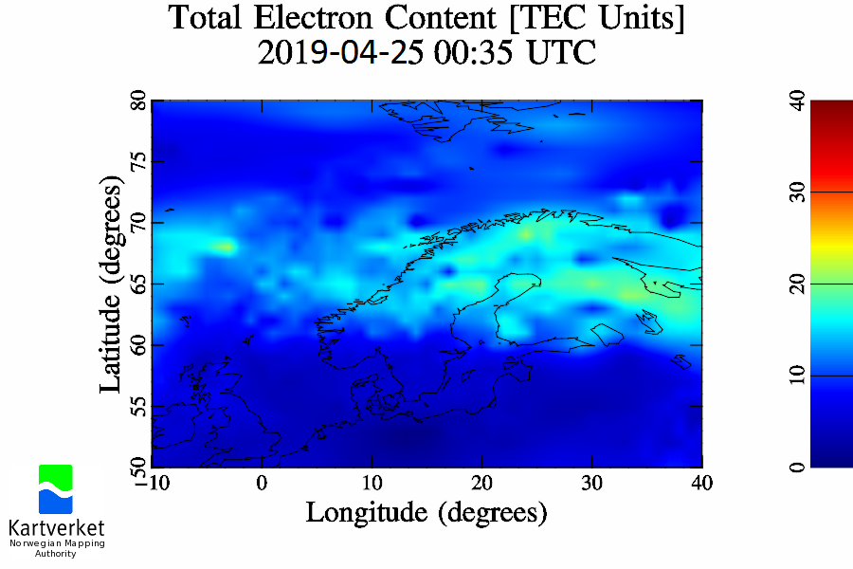
NMA
I.107 VTEC maps (Northern Europe)
Notes:
Periodically enhanced VTEC values in the auroral oval region during night. Such observations are typically related to particle precipitation in the auroral zone and/or plasma transport from the dayside.
<number>

Slide 4
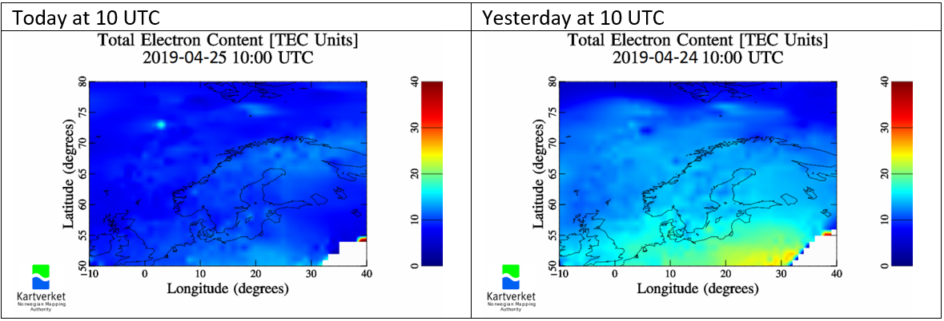
NMA
I.107 VTEC maps (Northern Europe)
Notes:
TEC depletion in the morning. (Lower-than-normal TEC values during the day over large areas)
<number>

Slide 5
Afternoon…

Slide 6
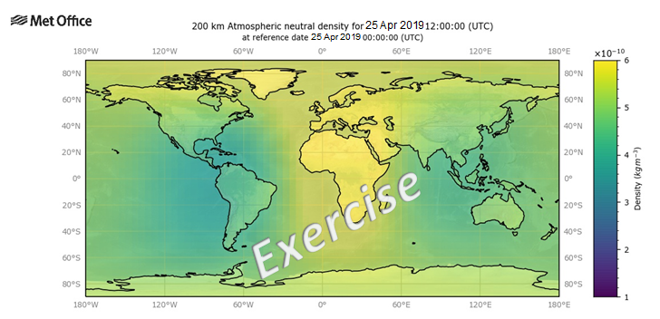
ATMDEN
I.132 Atmospheric Density Estimates of Forecast and Prior Total Density for Atmopsheric Drag Calculation
Notes:
Significantly enhanced atmospheric density starting 12 UT
<number>

Slide 7
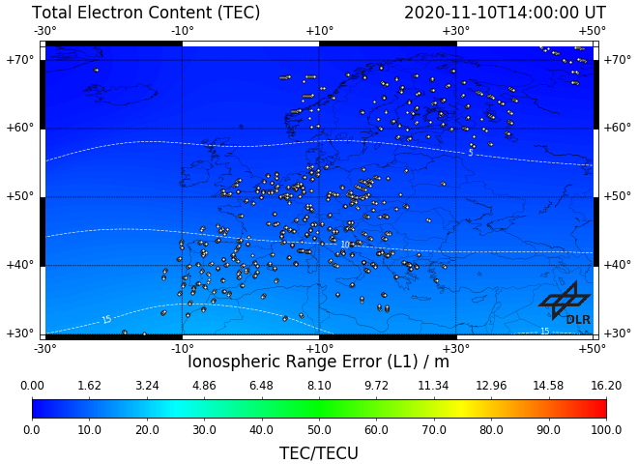
2020-11-18
Notes:
Enhanced TEC (compared to quiet conditions) over central Europe in the afternoon hours
<number>

