Slide 1
The following plots, graphs and information have been generated in the context of a SWESNET Consistent Communication exercise. The data has been taken from past periods (in 2017 or other years) and have been partially modified in order to support the communication exercise activity. It does not reflect the real-time space weather conditions and should not be used or distributed outside of the coordinated event exercise.

Slide 2
Issue time of the data:
YYYY – M1 – D3 UTC

Slide 3
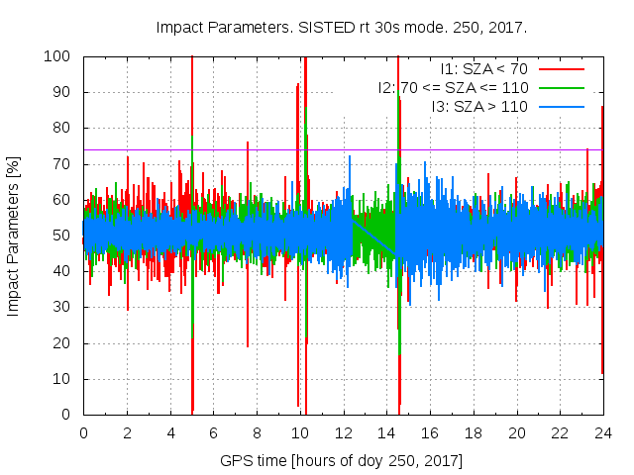
Notes:
4 flare impacts on ionosphere detected
4 alarms have been raised
<number>

Slide 4
SISTED Latest Issue Time: 2020-11-17 05:01:30 GPS Time
simultaneous ionospheric TEC increase in 93% Sunlit GNSS rays
SISTED Latest Issue Time: 2020-11-17 09:54:00 GPS Time
simultaneous ionospheric TEC increase in 92.2% Sunlit GNSS rays
SISTED Latest Issue Time: 2020-11-17 10:15:00 GPS Time
simultaneous ionospheric TEC increase in 75.1% Sunlit GNSS rays
SISTED Latest Issue Time: 2020-11-17 14:33:00 GPS Time
simultaneous ionospheric TEC increase in 100% Sunlit GNSS rays
Notes:
4 flare impacts on ionosphere detected
4 alarms have been raised
4 flare impacts on ionosphere detected
4 alarms have been raised
<number>

Slide 5
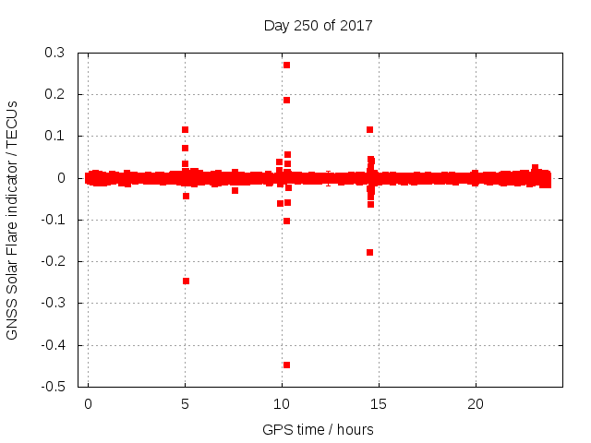

Slide 6
SOLERA-drift Latest Issue Time: 2020-11-17 05:01:30 GPS Time
SOLERA value of 2 TECUs at subsolar point, equivalent to EUV flux rat
SOLERA-drift Latest Issue Time: 2020-11-17 09:53:30 GPS Time
SOLERA value of 2 TECUs at subsolar point, equivalent to EUV flux rate
SOLERA-drift Latest Issue Time: 2020-11-17 10:15:30 GPS Time
SOLERA value of 2 TECUs at subsolar point, equivalent to EUV flux rate
SOLERA-drift Latest Issue Time: 2020-11-17 14:33:00 GPS Time
SOLERA value of 10 TECUs at subsolar point, equivalent to EUV flux rate

