Slide 1
The following plots, graphs and information have been generated in the context of a SWESNET Consistent Communication exercise. The data has been taken from past periods (in 2017 or other years) and have been partially modified in order to support the communication exercise activity. It does not reflect the real-time space weather conditions and should not be used or distributed outside of the coordinated event exercise.

Slide 2
Issue time of the data:
YYYY – M1 – D2 UTC

Slide 3
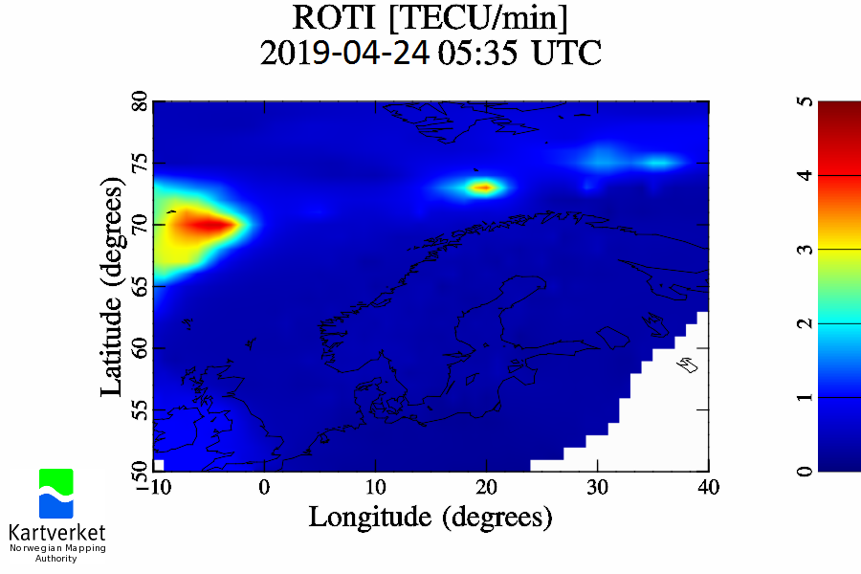
NMA
I.109a ROTI maps (Northern Europe)
2017-09-07
Notes:
Disturbances in the Auroral region (70°N) for around midnight (24.04.2019 00:00 UT) and in the morning hours (examples 24.04.2019 at 5:35 UT and 6:45 UT). These perturbations are still ongoing. This level of activity is common at these latitudes, and indicates minor activity in the auroral zone.
<number>

Slide 4
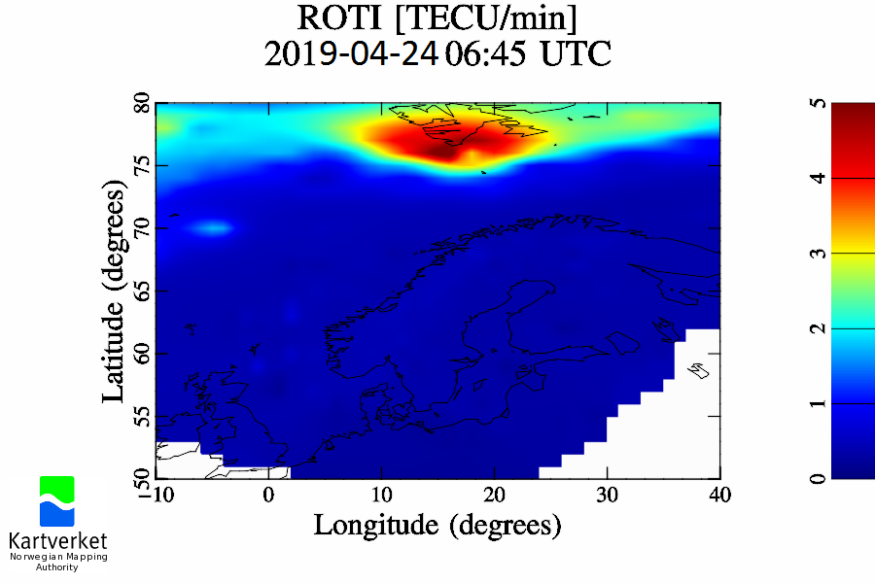
NMA
I.109a ROTI maps (Northern Europe)
2017-09-07
Notes:
Disturbances in the Auroral region (70°N) for around midnight (24.04.2019 00:00 UT) and in the morning hours (examples 24.04.2019 at 5:35 UT and 6:45 UT). These perturbations are still ongoing. This level of activity is common at these latitudes, and indicates minor activity in the auroral zone.
<number>

Slide 5
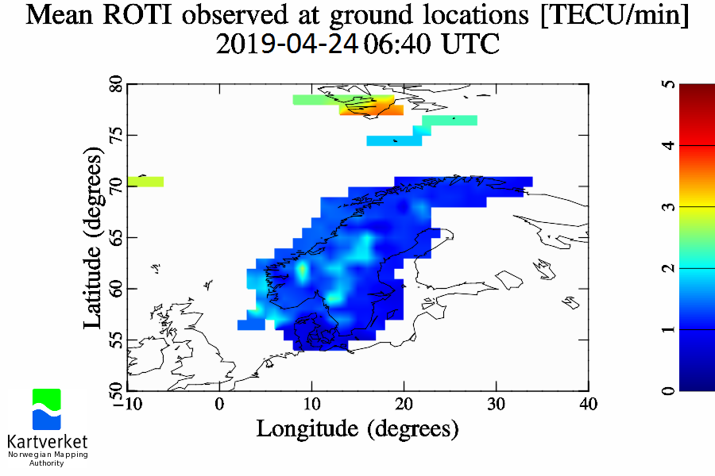
NMA
I.109b ROTI@Ground maps (Fennoscandia)
2017-09-07
Notes:
Some perturbations in Scandinavia. Intermittent strong perturbations at very high latitudes (> 70°N, still ongoing)
<number>

Slide 6
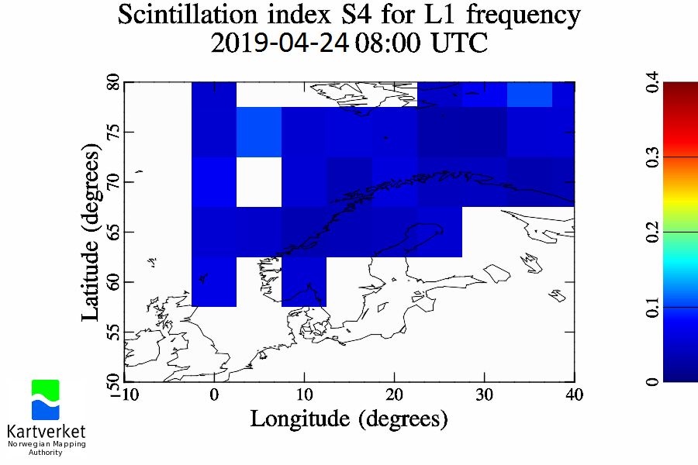
NMA
I.110a S4 maps (Northern Europe)
2020-11-17
Notes:
Scintillations: S4 quiet, sigma Phi intermittent phase scintillations in the auroral region (70-75°N) at nighttime
<number>

Slide 7
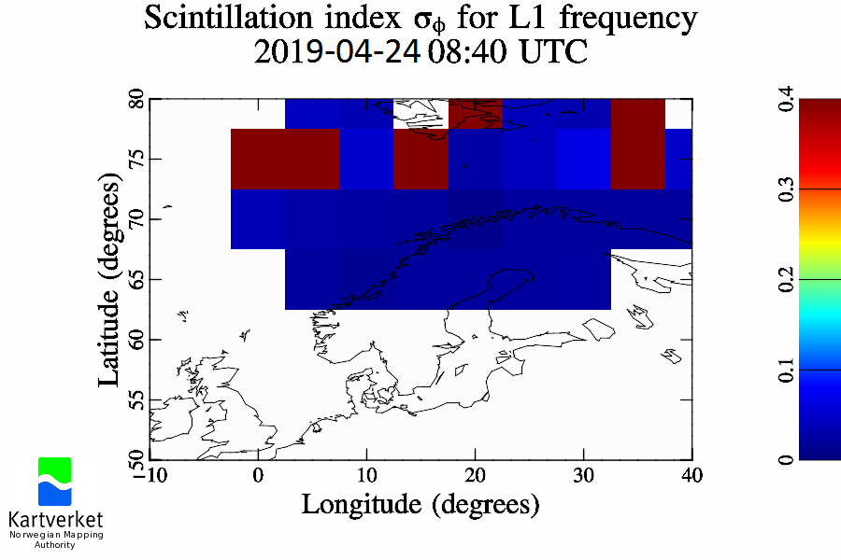
NMA
I.110a S4 maps (Northern Europe)
2020-11-17
Notes:
Scintillations: S4 quiet, sigma Phi intermittent phase scintillations in the auroral region (70-75°N) at nighttime
<number>

Slide 8
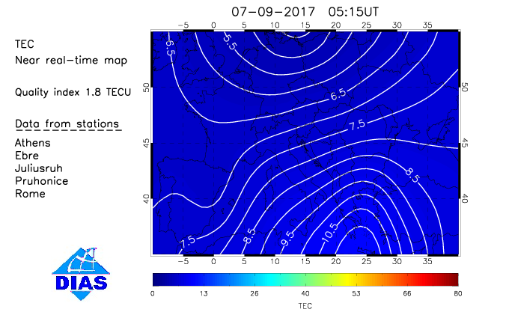
EIS
I.117 Near-real-time TEC maps for the European region
(based on the TaD model)
Notes:
EIS Near Real Time TEC Maps, obtained from the TaD model using data from the DIAS/EIS ionosonde network.
Slightly increased TEC values (compared to normal conditions) are currently observed over Europe.
<number>

Slide 9
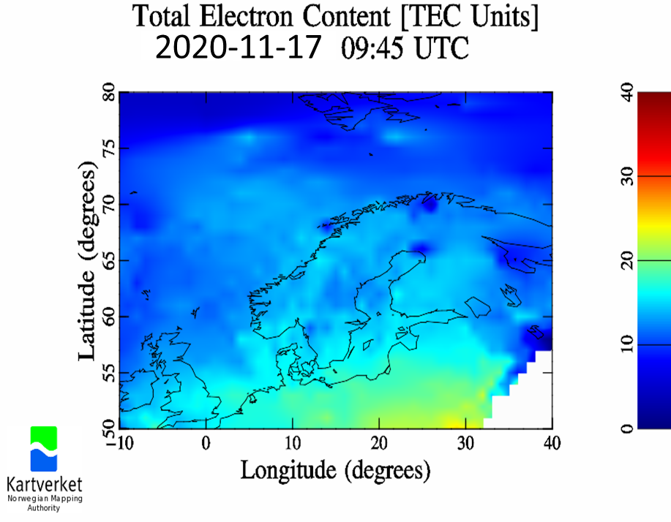
NMA
I.107 VTEC maps (Northern Europe)
Notes:
TEC quiet
<number>

Slide 10
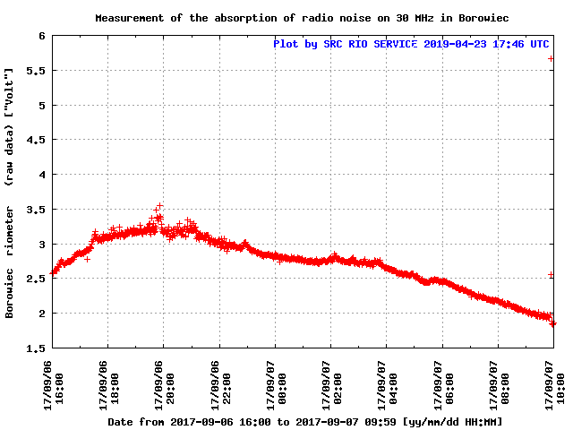
SRC RIO
I.134a Borowiec Riometer raw [V] and relative [dB]
Notes:
On data from Borowiec the decrease from quiet day curve is observed showing the absorption in ionospheric D layer is still present. At 10:00 detection of solar flare on riometer data.
<number>

Slide 11
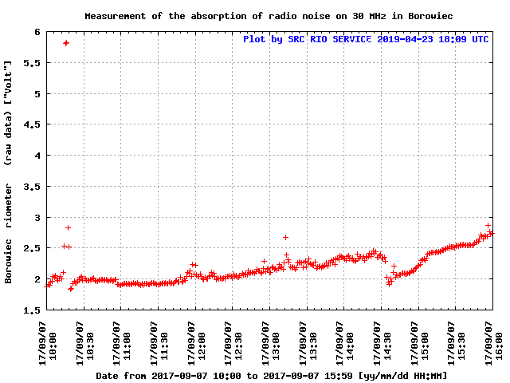
SRC RIO
I.134a Borowiec Riometer raw [V] and relative [dB]
Notes:
At 14:30 the absorption following the solar flare was detected. No detection of solar flare at 14:30, (no increase of impulse on 30 MHz, local time 16:30, large Solar Zenith Angle).
<number>

Slide 12
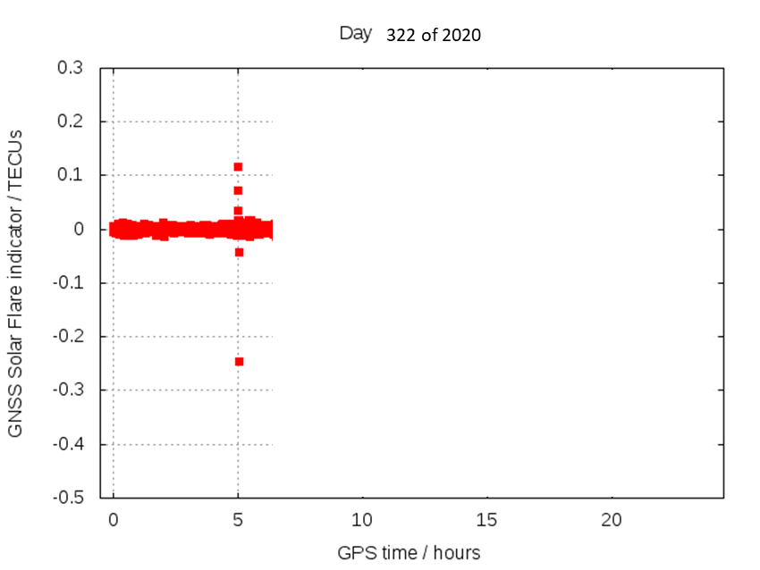
IonSAT
I.123b SOLERA-drift
I.123e SOLERA-drift warning
SOLERA-drift Latest Issue Time: 2020-11-17 05:01:30 GPS Time
SOLERA value of 2 TECUs at subsolar point, equivalent to EUV flux rat

Slide 13
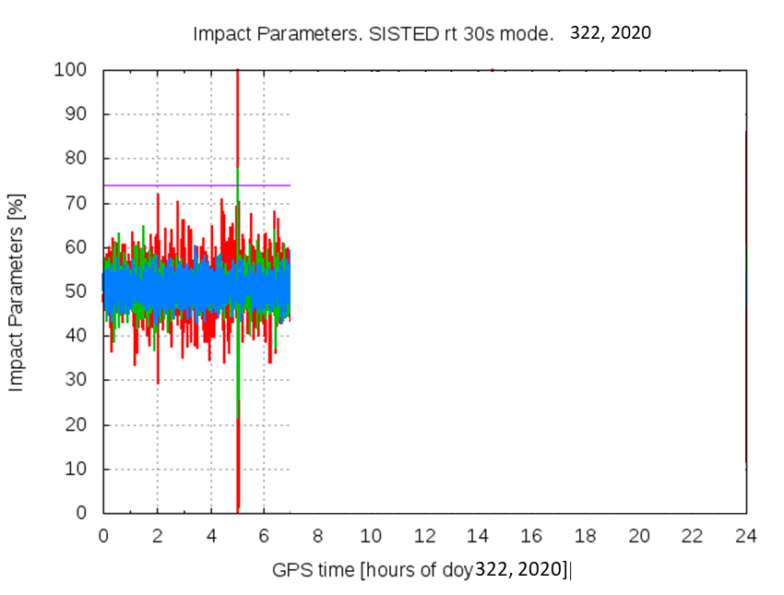
IonSAT
I.123a SISTED (Sunlit Ionosphere Sudden TEC Enhancement)
I.123d SISTED warning
SISTED Latest Issue Time: 2020-11-17 05:01:30 GPS Time
simultaneous ionospheric TEC increase in 93% Sunlit GNSS rays

