Slide 1
The following plots, graphs and information have been generated in the context of a SWESNET Consistent Communication exercise. The data has been taken from past periods (in 2017 or other years) and have been partially modified in order to support the communication exercise activity. It does not reflect the real-time space weather conditions and should not be used or distributed outside of the coordinated event exercise.

Slide 2
Issue time of the data:
YYYY – M1 – D1 UTC

Slide 3
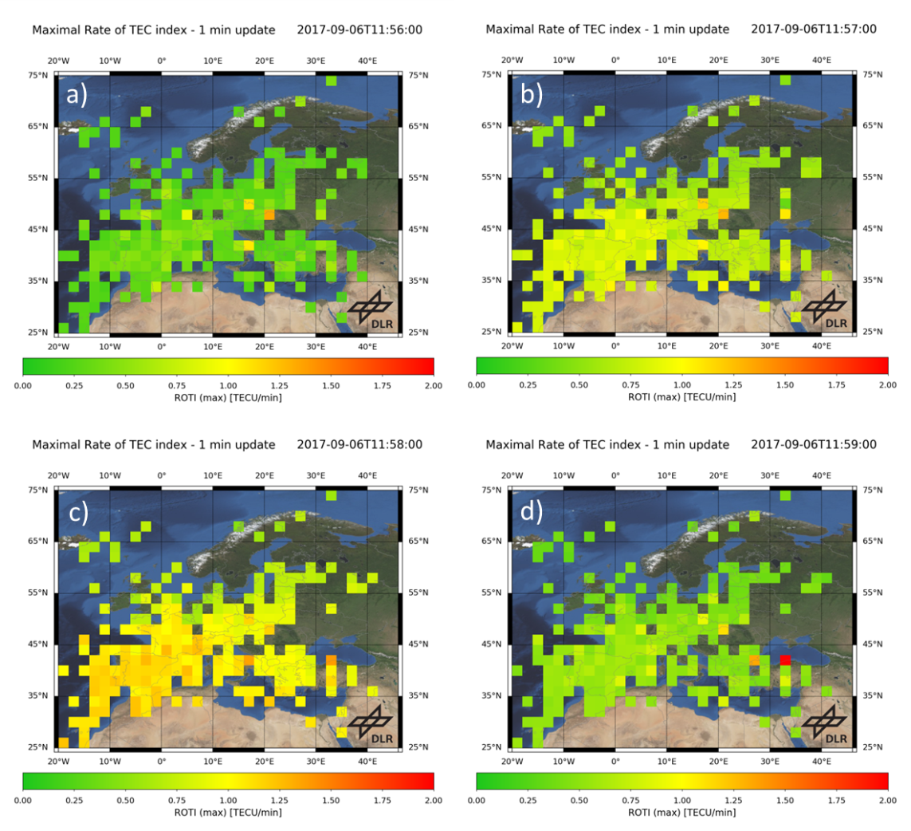
IMPC
I.124 The Rate of change of TEC index (ROTI) maps for Europe

Slide 4
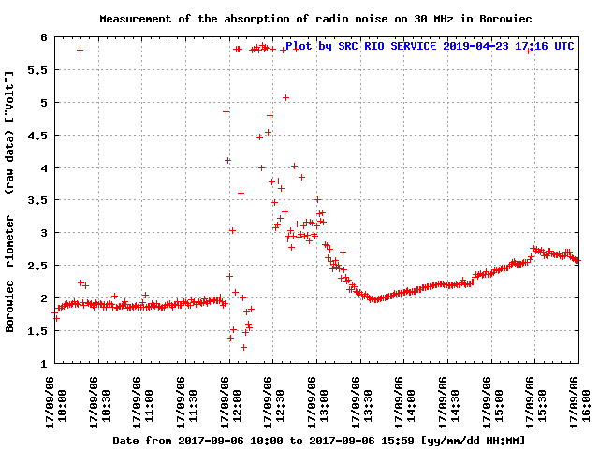
SRC RIO
I.134a Borowiec Riometer raw [V] and relative [dB]
Notes:
Observed strong solar flare on 30 MHz on riometer data in Boroviec, Poland
The decrease from quiet
day curve is observed
showing the absorption
in D layer
<number>

Slide 5
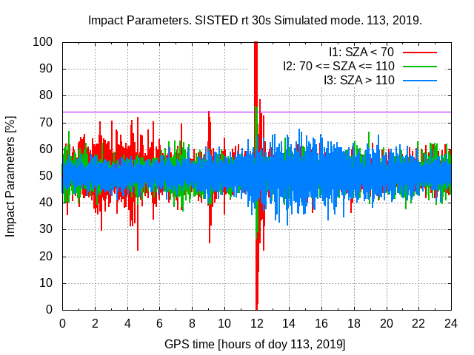
IonSAT
I.123a SISTED (Sunlit Ionosphere Sudden TEC Enhancement)
Notes:
Ionosphere impact of flares detected at 12:02
Very strong sudden changes in TEC on the day side (exceeding far the theshold, purple horizontal line)
<number>

Slide 6
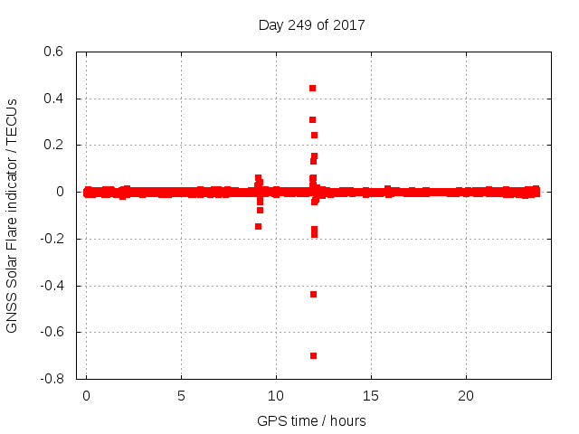
IonSAT
I.123b SOLERA-drift
Notes:
Ionosphere impact of flares detected at 12:02
Very strong sudden changes in TEC on the day side (exceeding far the theshold, purple horizontal line)
<number>

