Slide 1
The following plots, graphs and information have been generated in the context of a SWESNET Consistent Communication exercise. The data has been taken from past periods (in 2017 or other years) and have been partially modified in order to support the communication exercise activity. It does not reflect the real-time space weather conditions and should not be used or distributed outside of the coordinated event exercise.

Slide 2
Issue time of the data:
YYYY – M1 – D2 UTC

Slide 3
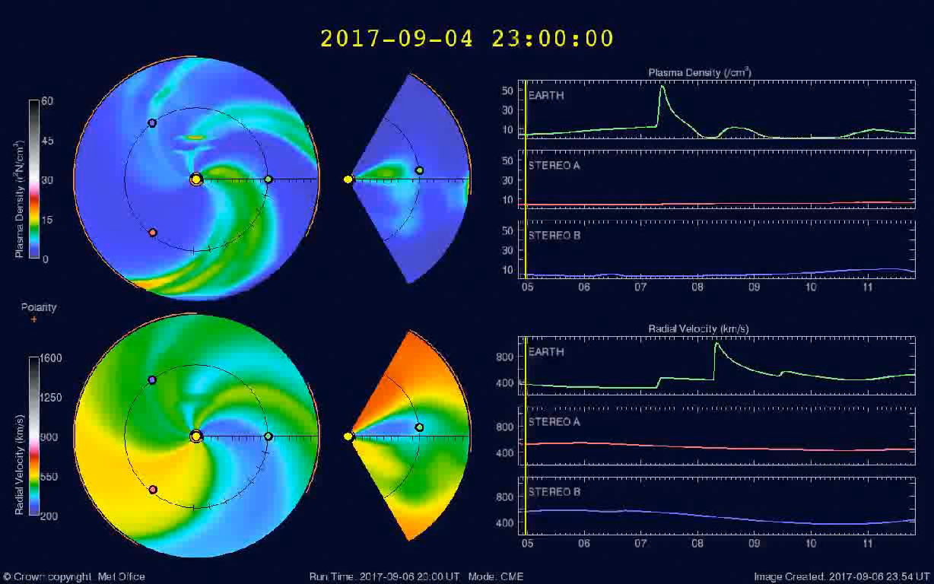
H-ESC Product: H.101a/103a ENLIL/E – 3D MHD Model of the Heliosphere
2020-11-14 to 21
15 16 17 18 19 20 21
15 16 17 18 19 20 21
2020-11-16
2020-11-16
UTC (@ 21.5 Rs) | Longitude (deg) | Latitude (deg) | Half Width (deg) | Speed (km/s)
2020-11-16T14:30:00Z | 15.0 | -10.0 | 50.0 | 1200.0
2020-11-14T23:42:00Z | 6.0 | -15.0 | 41.0 | 1200.0
2020-11-12T23:47:00Z | 90.0 | 5.0 | 33.0 | 366.0

Slide 4
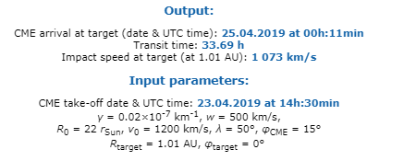
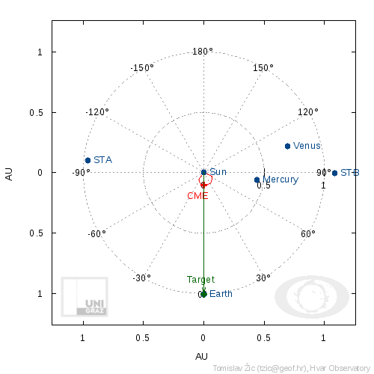
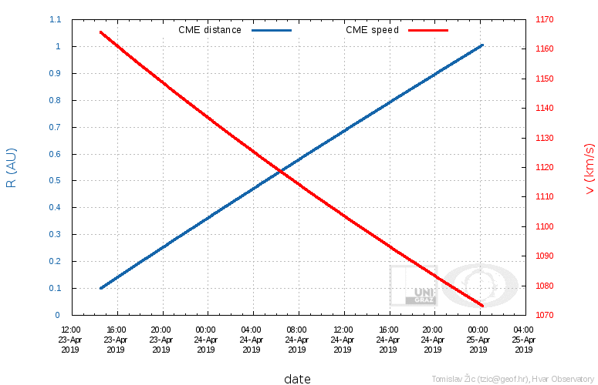
H-ESC Product: H.103b DBM – Drag Based Model

Slide 5
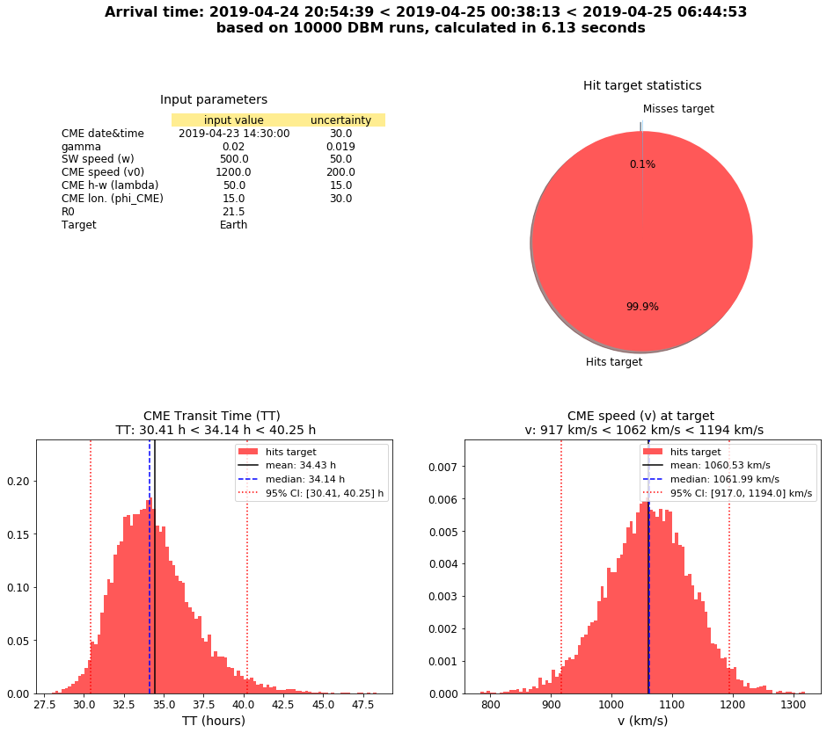
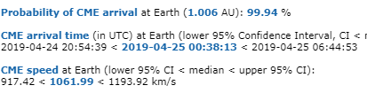
H-ESC Product: H.108b DBEM – Drag Based Ensemble Model

Slide 6
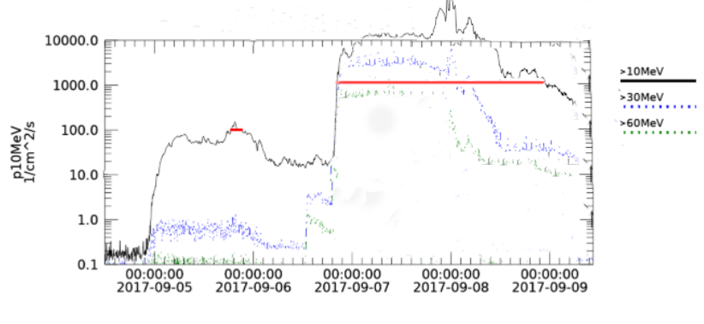
H-ESC Product: H.105a SEP/E – Near Earth Energetic Protons (GOES)
2020-11-15
2020-11-16
2020-11-17
2020-11-18
2020-11-19

Slide 7
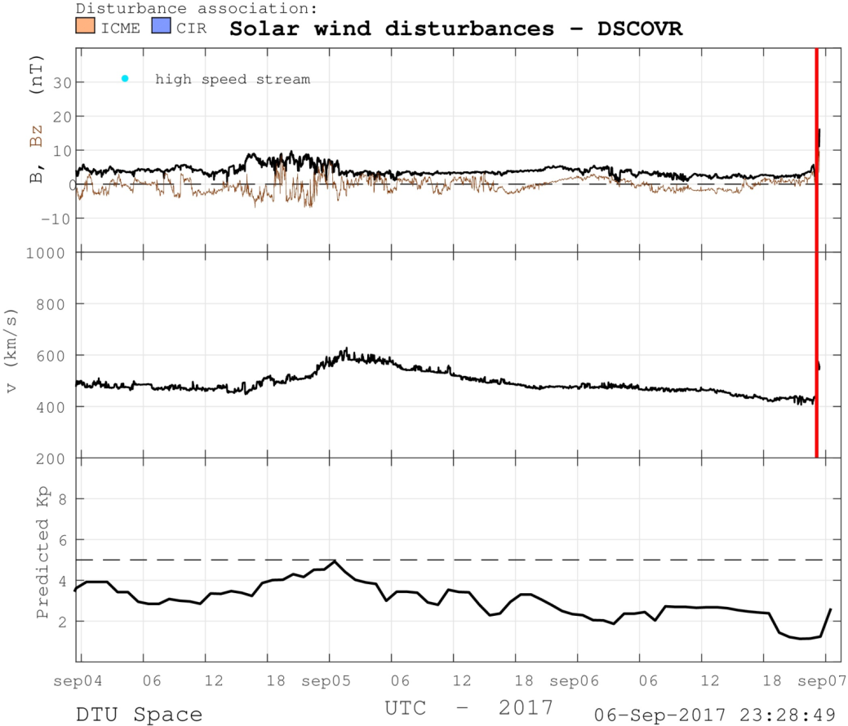
H-ESC Product: H.106b AWARE – Automated detection of solar wind features
2020-11-14
2020-11-15
2020-11-16
2020-11-17
2020
16 Nov 2020 23:18:49

