Slide 1
The following plots, graphs and information have been generated in the context of a SWESNET Consistent Communication exercise. The data has been taken from past periods (in 2017 or other years) and have been partially modified in order to support the communication exercise activity. It does not reflect the real-time space weather conditions and should not be used or distributed outside of the coordinated event exercise.

Slide 2
Issue time of the data:
YYYY – M1 – D4 UTC

Slide 3
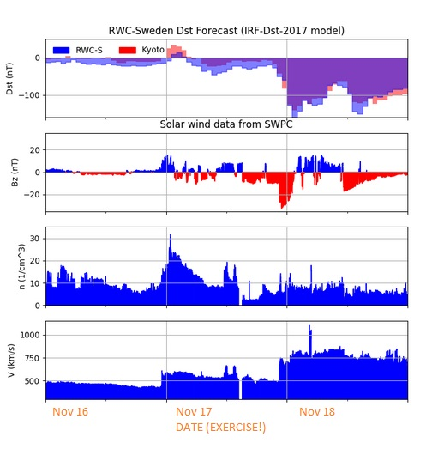
G.135

Slide 4
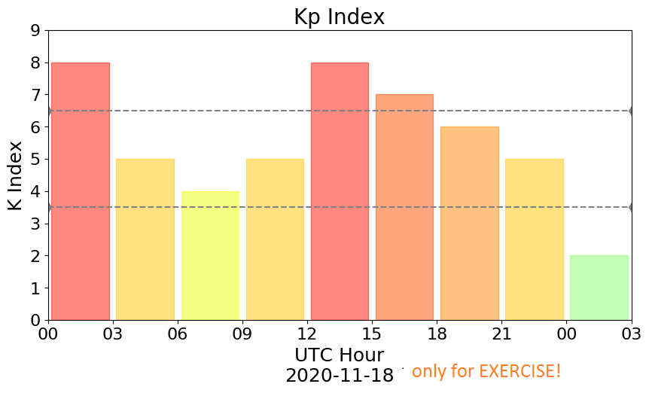
G.134 (similar)

Slide 5
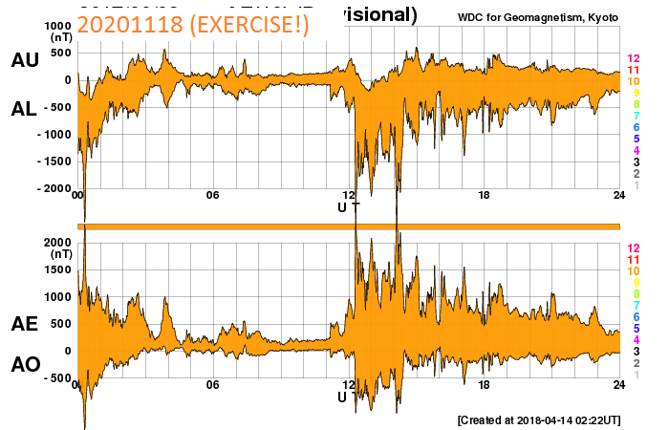
G.145 (similar)

Slide 6
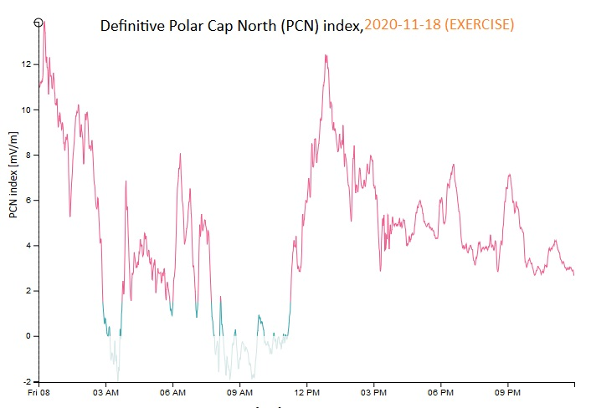
G.144

Slide 7
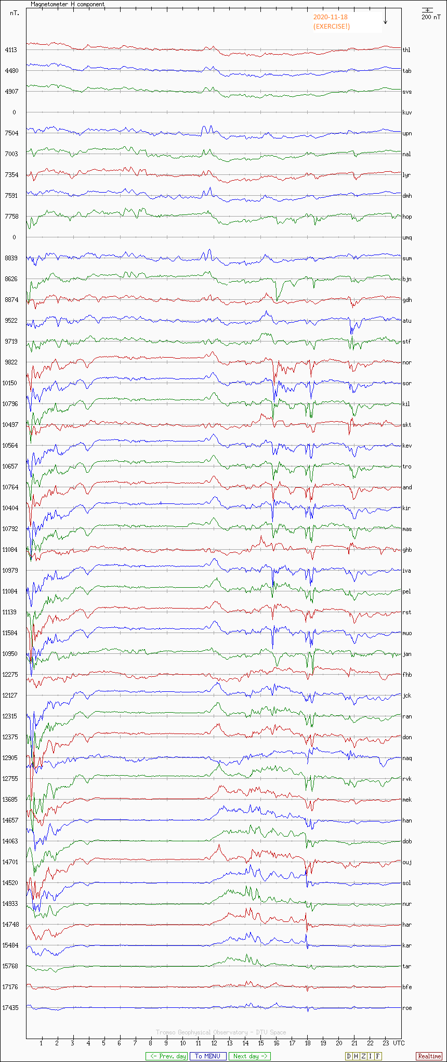
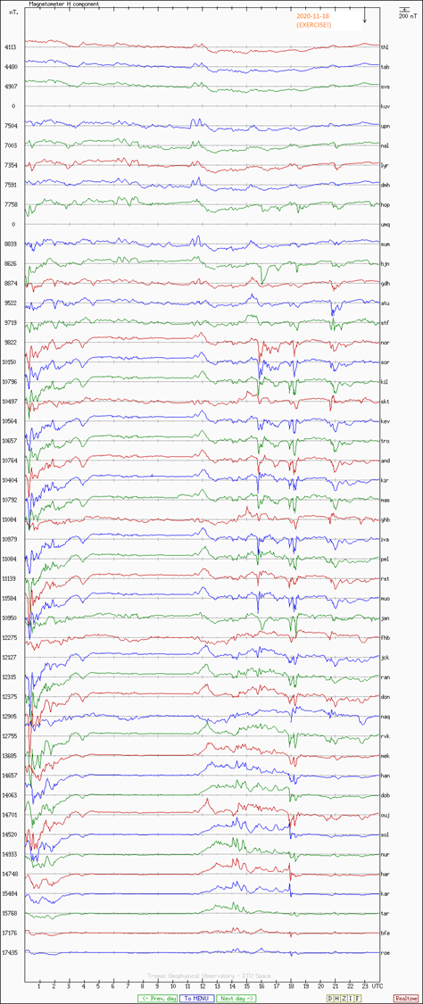
G.101

Slide 8
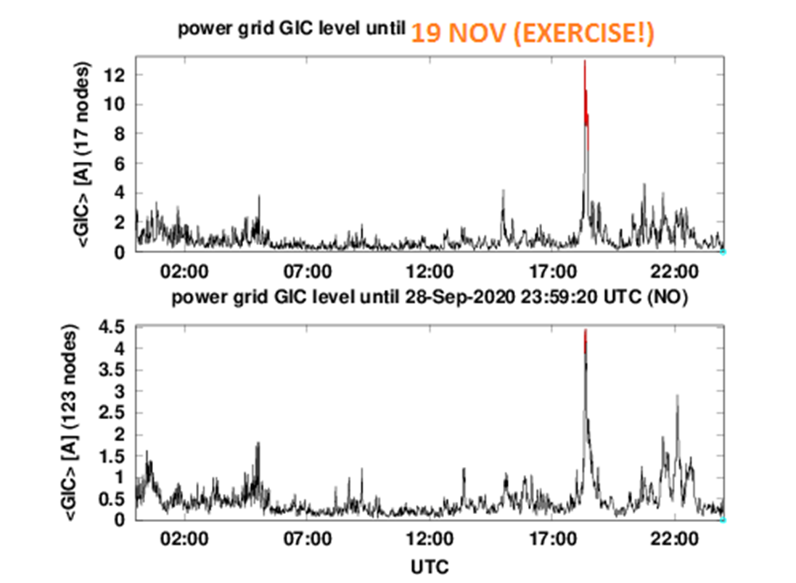

Slide 9
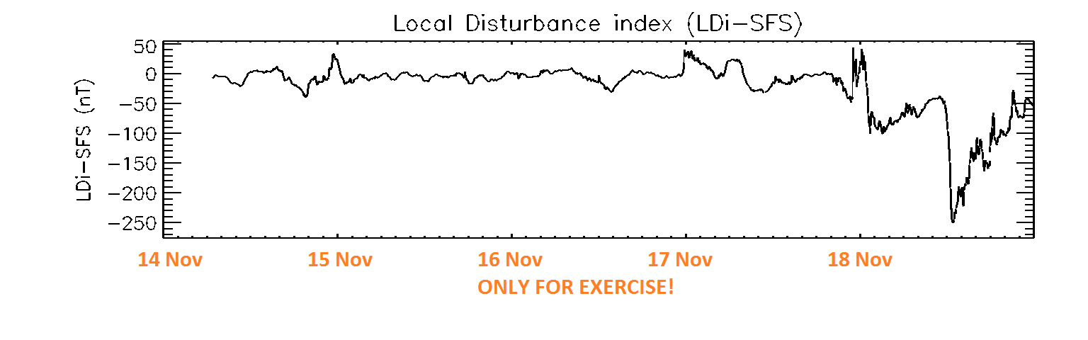
G.126

Slide 10
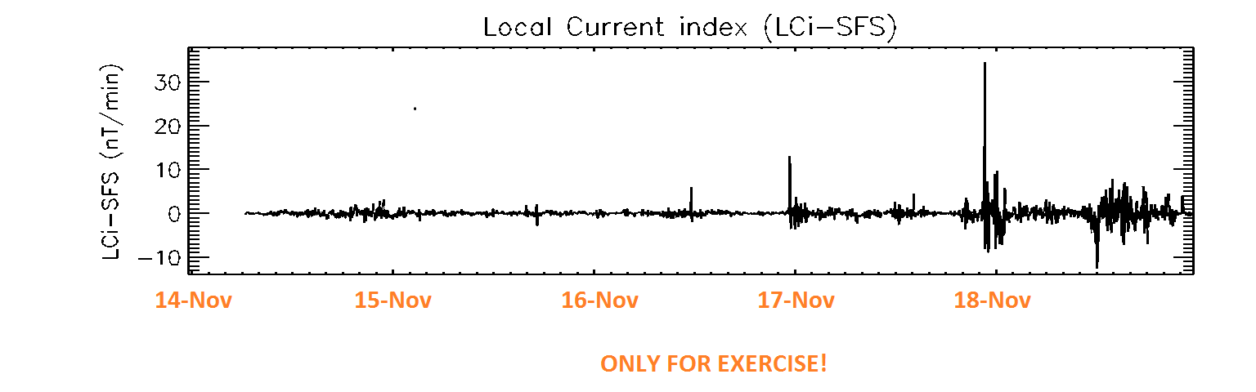
G.127

